Slide 1
Understanding Kubernetes
[Session 4] Container Networking

Slide 2
Topics
K8s Networking
[Prerequisite - 1] Bridge, VLAN, VXLAN, vEtH etc
[Prerequisite - 2] Namespace
[Prerequisite - 3] Ip-tables
Demo: How namespace networking works
Introduction
containers in the same pod
pods on the same node
pods on different nodes
DNS
K8s Services
Understanding services
Kube-proxy
Load-balancer, Ingress
K8s CNI
Introduction
Specification
Plugins
Sample plugins
3rd party plugins
K8s Networking model (general topics)

Slide 3
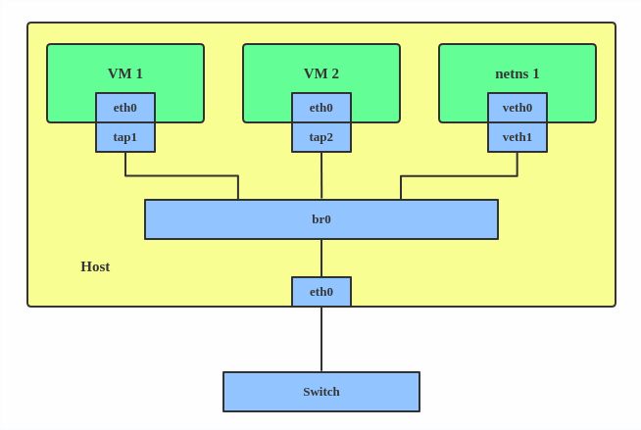
Bridge
A Linux bridge behaves like a network switch. It forwards packets between interfaces that are connected to it. It’s usually used for forwarding packets on routers, on gateways, or between VMs and network namespaces on a host.
Use a bridge when you want to establish communication channels between VMs, containers, and your hosts.
##This creates a bridge device named br0 and sets two TAP devices (tap1, tap2), a VETH device (veth1), and a physical device (eth0) as its slaves, as shown in the diagram above.
#
$ ip link add br0 type bridge
$ ip link set eth0 master br0
$ ip link set tap1 master br0
$ ip link set tap2 master br0
$ ip link set veth1 master br0
Notes:
https://developers.redhat.com/blog/2018/10/22/introduction-to-linux-interfaces-for-virtual-networking

Slide 4
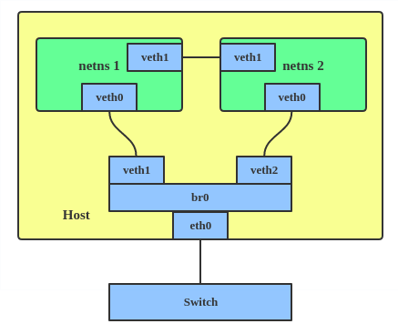
VETH
The VETH (virtual Ethernet) device is a local Ethernet tunnel. Devices are created in pairs, as shown in the diagram below.
Packets transmitted on one device in the pair are immediately received on the other device. When either device is down, the link state of the pair is down.
Use a VETH configuration when namespaces need to communicate to the main host namespace or between each other.
$ ip netns add net1
$ ip netns add net2
$ ip link add veth1 netns net1 type veth peer name veth2 netns net2

Slide 5
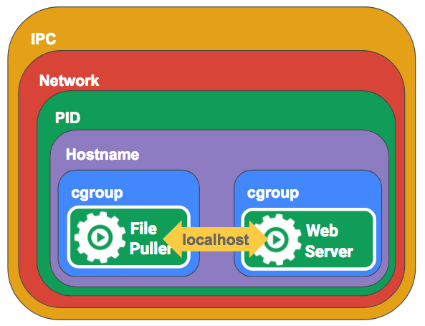
Namespaces
A namespace wraps a global system resource in an abstraction that makes it appear to the processes within the namespace that they have their own isolated instance of the global resource. Changes to the global resource are visible to other processes that are members of the namespace, but are invisible to other processes.
Docker/kubernetes makes use of kernel namespaces to provide the isolated workspace called the container. When you run a container, Docker/k8s creates a set of namespaces for that container. These namespaces provide a layer of isolation. Each aspect of a container runs in a separate namespace and its access is limited to that namespace.
Mount - isolate filesystem mount points
UTS - isolate hostname and domainname
IPC - isolate interprocess communication (IPC) resources
PID - isolate the PID number space
Network - isolate network interfaces
User - isolate UID/GID number spaces
Cgroup - isolate cgroup root directory
A process can use all the resources on the physical machine it runs on, thus starving other processes for resources. In order to limit that, Linux has a feature called cgroups. Processes can be run in a cgroup much like a namespace but the cgroup limits the resources that the process can use. These resources include CPU, RAM, block I/O, network I/O etc
Notes:
https://developers.redhat.com/blog/2018/10/22/introduction-to-linux-interfaces-for-virtual-networking

Slide 6
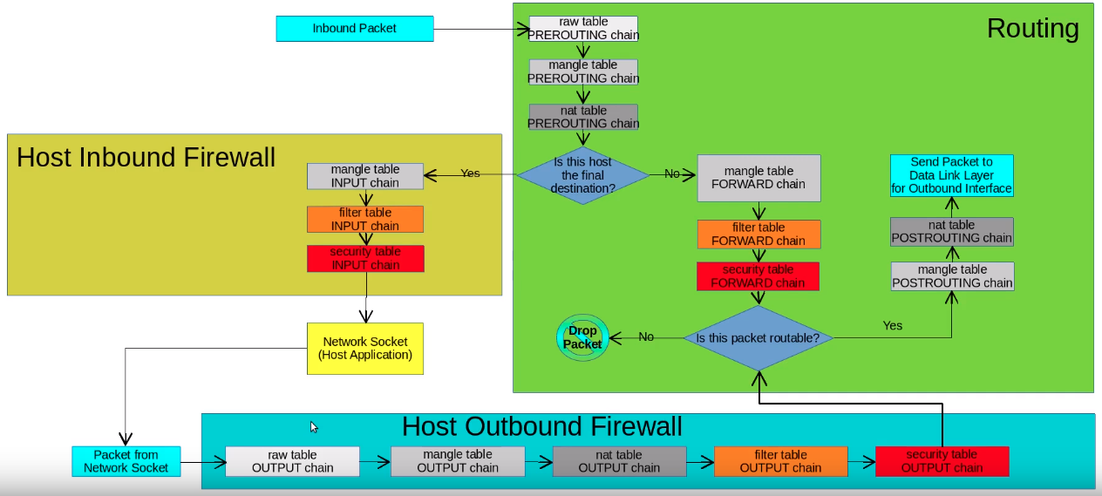
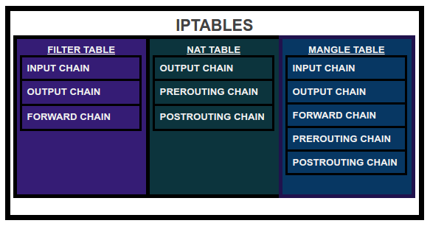
IpTables
iptables is a user-space utility program that allows users to configure specific rules that will be enforced by the kernel’s netfilter framework. It acts as a packet filter and firewall that examines and directs traffic based on port, protocol and other criteria.
Tables is the name for a set of chains.
Chain is a collection of rules.
Rule is condition used to match packet.
Target is action taken when a possible rule matches. Examples of the target are ACCEPT, DROP, QUEUE.
Ip-table flowchart
Example 1:
To block all service requests on port 80, enter:
$ iptables -A INPUT -p tcp --dport 80 -j DROP
Example 2:
only accept connection to tcp port 80 (Apache) if ip is between 192.168.1.100 and 192.168.1.200
$ iptables t filter -A INPUT -p tcp --destination-port 80 -m iprange --src-range 192.168.1.100-192.168.1.200 -j ACCEPT

Slide 7
Demo
Create a Namespace
$ ip netns add red
Create another Namespace
$ ip netns add blue
Verify What is there inside namespace
$ ip netns exec red ip link
1: lo: <LOOPBACK> mtu 65536 qdisc noop state DOWN mode DEFAULT group default qlen 1000
link/loopback 00:00:00:00:00:00 brd 00:00:00:00:00:00
$ ip netns exec blue ip link
1: lo: <LOOPBACK> mtu 65536 qdisc noop state DOWN mode DEFAULT group default qlen 1000
link/loopback 00:00:00:00:00:00 brd 00:00:00:00:00:00
Check the route
$ ip netns exec red route
Kernel IP routing table
Destination Gateway Genmask Flags Metric Ref Use Iface
$ ip netns exec red arp
$
eth0
192.168.0.10/24

Slide 8
Demo
Create a virtual network between 2 namespaces
$ ip link add veth-red type veth peer name veth-blue
Attach the veth pair to namespaces
$ ip link set veth-red netns red
$ ip link set veth-blue netns blue
veth-red
veth-blu
Assign ip address
$ ip -n red addr add 192.168.15.1/24 dev veth-red
$ ip -n blue addr add 192.168.15.2/24 dev veth-blue
veth-red
veth-blu
Make interface up
$ ip -n red link set veth-red up
$ ip -n blue link set veth-blue up
Now check route table
$ ip netns exec red route
Kernel IP routing table
Destination Gateway Genmask Flags Metric Ref Use Iface
192.168.15.0 * 255.255.255.0 U 0 0 0 veth-red
eth0
192.168.0.10/24
Now check ping
$ ip netns exec red ping 192.168.15.2
PING 192.168.15.2 (192.168.15.2) 56(84) bytes of data.
64 bytes from 192.168.15.2: icmp_seq=1 ttl=64 time=0.068 ms
64 bytes from 192.168.15.2: icmp_seq=2 ttl=64 time=0.060 ms

Slide 9
Demo
Create a bridge (Network switch) and Make it up
$ ip link add v-net-0 type bridge
$ ip link set dev v-net-0 up
Create a veth like before
$ ip link add veth-red type veth peer name veth-red-br
$ ip link add veth-blue type veth peer name veth-blue-br
veth-blue
veth-red
v-net-0
Attach one side to namespace and another to bridge
$ ip link set veth-red netns red
$ ip link set veth-red-br master v-net-0
$ ip link set veth-blue netns blue
$ ip link set veth-blue-br master v-net-0
veth-red-br
veth-blue-br
veth-yel-br
veth-gre-br
veth-yellow
veth-green
Assign Address and make the interfaces up
$ ip -n red addr add 192.168.15.1/24 dev veth-red
$ ip -n blue addr add 192.168.15.2/24 dev veth-blue
$ ip -n red link set veth-red up
$ ip link set veth-red-br up
$ ip -n blue link set veth-blue up
$ ip link set veth-blue-br up
eth0
192.168.0.10/24
Now PING!!!
$ ip netns exec red ping 192.168.15.2
PING 192.168.15.3 (192.168.15.3) 56(84) bytes of data.
64 bytes from 192.168.15.3: icmp_seq=1 ttl=64 time=0.124 ms
$ ip link set dev v-net-0 up

Slide 10
Demo
Ping to Host
Assign ip to bridge
$ ip add add 192.168.15.5/24 dev v-net-0
Now PING!!!
$ ping 192.168.15.5
PING 192.168.15.1 (192.168.15.1) 56(84) bytes of data.
64 bytes from 192.168.15.1: icmp_seq=1 ttl=64 time=0.075 ms
$ ip link set dev v-net-0 up
veth-red
veth-blue
v-net-0
veth-red-br
veth-blue-br
Now PING to internet or the eth0 !!!
$ ip netns exec red ping 8.8.8.8
connect: Network is unreachable
$ ip link set dev v-net-0 up
veth-yel-br
veth-gre-br
veth-yellow
veth-green
We need to add route …[Different network]
$ ip netns exec red ip route add default via 192.168.15.5
Internet 8.8.8.8
Also we need to set NAT and some ip-tables rule
$ iptables -P FORWARD DROP
$ iptables -F FORWARD
$ iptables -t nat -F
$ iptables -t nat -A POSTROUTING -s 192.168.15.5/24 -o wlo1 -j MASQUERADE
$ iptables -A FORWARD -i wlo1 -o v-net-0 -j ACCEPT
$ iptables -A FORWARD -o wlo1 -i v-net-0 -j ACCEPT
eth0
192.168.0.10/24
Now PING to internet or the eth0 !!!
$ ip netns exec red ping 8.8.8.8
PING 8.8.8.8 (8.8.8.8) 56(84) bytes of data.
64 bytes from 8.8.8.8: icmp_seq=1 ttl=55 time=22.1 ms
$ ip link set dev v-net-0 up

Slide 11
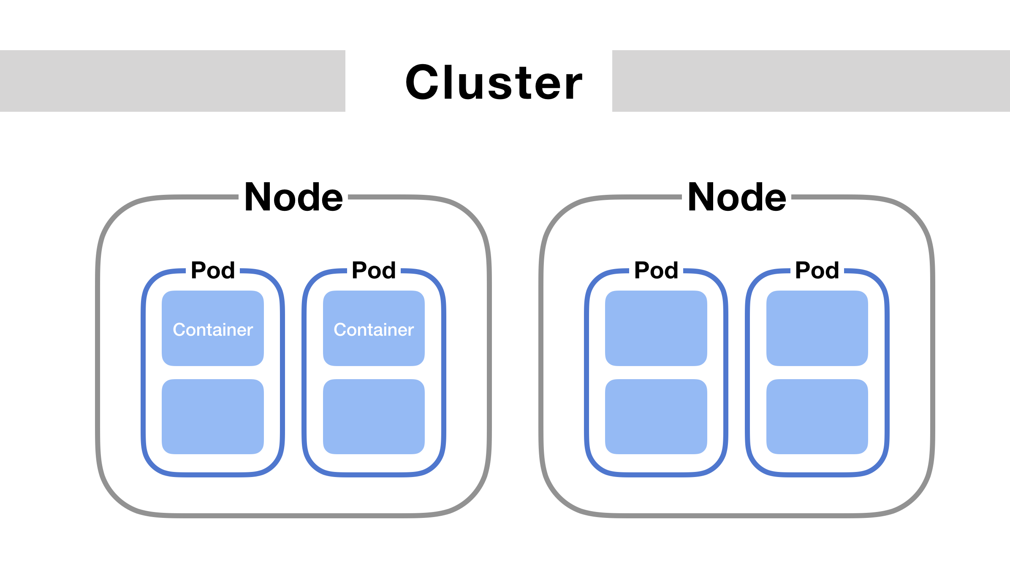
K8s Networking
Kubernetes networking builds on top of the Docker and Netfilter constructs to tie multiple components together into applications. There are five essential things to understand about networking in Kubernetes
Communication between containers in the same pod
Communication between pods on the same node
Communication between pods on different nodes
Communication between pods and services
How does DNS work? How do we discover IP addresses?

Slide 12
Pods
The smallest unit of deployment in a Kubernetes cluster is the Pod, and all of the constructs related to scheduling and orchestration assist in the deployment and management of Pods.
A Pod encapsulates one or more containers.
Containers in the same Pod always run on the same host. They share resources such as the network namespace and storage.
Each Pod has a routable IP address assigned to it, not to the containers running within it. Having a shared network space for all containers means that the containers inside can communicate with one another over the localhost address.

Slide 13
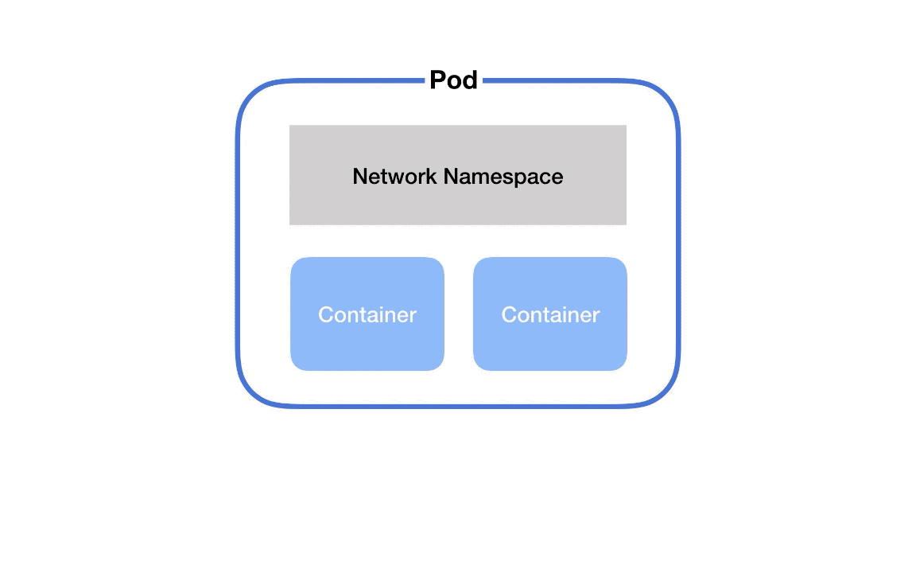
Containers in the same pod
Containers in a pod share namespaces among them.
There’s a secret container that runs on every pod in Kubernetes. This container’s #1 job is to keep the namespace open in case all the other containers on the pod die. It’s called the pause container. Its nothing but network namespace.
Containers in a Pod run on a “logical host”; they use the same network namespace (the same IP address and port space, from pause container), and the same IPC namespace. They can also use shared volumes. These properties make it possible for these containers to efficiently communicate, ensuring data locality. Also, Pods enable you to manage several tightly coupled application containers as a single unit.
Why does Kubernetes use a Pod as the smallest deployable unit, and not a single container?
While it would seem simpler to just deploy a single container directly, there are good reasons to add a layer of abstraction represented by the Pod. A container is an existing entity, which refers to a specific thing. That specific thing might be a Docker container, but it might also be a rkt container, or a VM managed by Virtlet. Each of these has different requirements.
What’s more, to manage a container, Kubernetes needs additional information, such as a restart policy, which defines what to do with a container when it terminates, or a liveness probe, which defines an action to detect if a process in a container is still alive from the application’s perspective, such as a web server responding to HTTP requests.
Instead of overloading the existing “thing” with additional properties, Kubernetes architects have decided to use a new entity, the Pod, that logically contains (wraps) one or more containers that should be managed as a single entity.

Slide 14
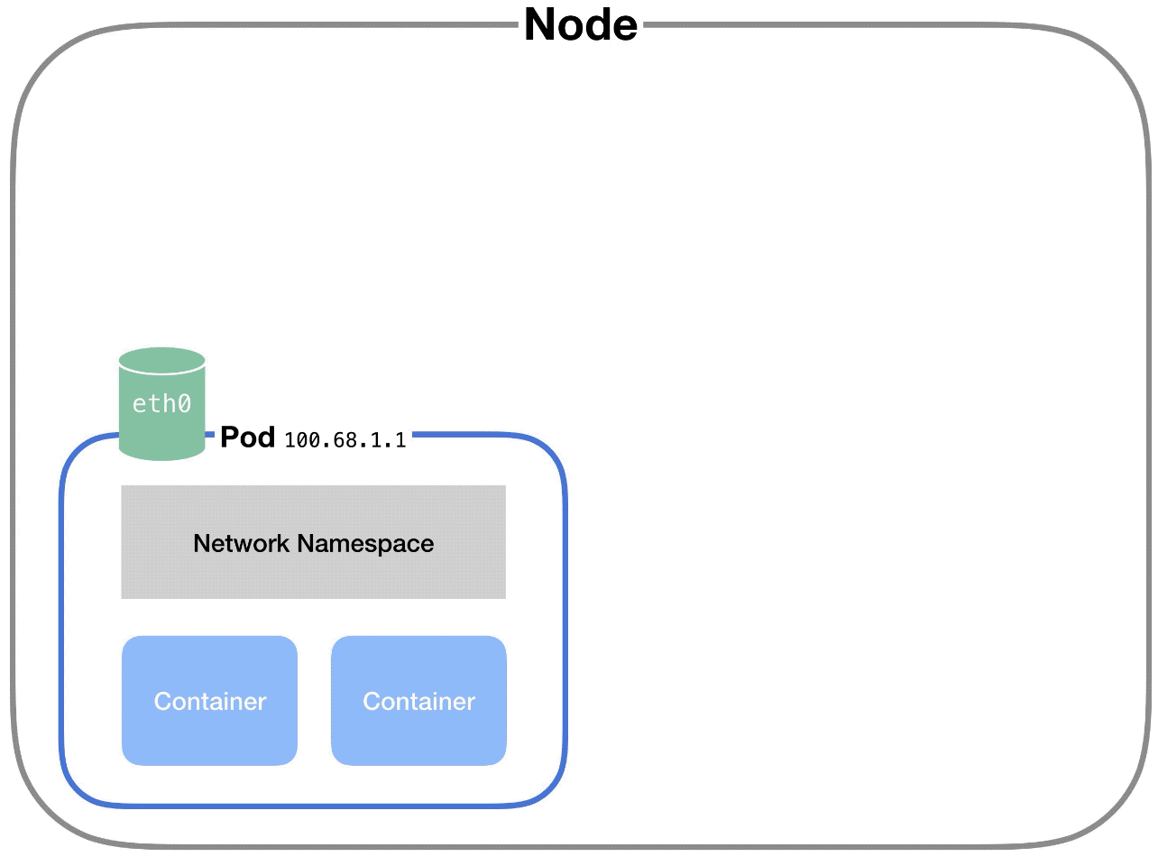
Pods on the same node
Each pod has its own IP address.
And each pod thinks it has a totally normal ethernet device called eth0 to make network requests through. But Kubernetes is faking it – it’s just a virtual ethernet connection.
Each pod’s eth0 device is actually connected to a virtual ethernet device in the node.
A virtual ethernet device is a tunnel that connects the pod’s network with the node. This connection has two sides – on the pod’s side, it’s named eth0, and on the node’s side, it’s named vethX.
When a pod makes a request to the IP address of another node, it makes that request through its own eth0 interface. This tunnels to the node’s respective virtual vethX interface.
But then how does the request get to the other pod?
The node uses a network bridge.

Slide 15
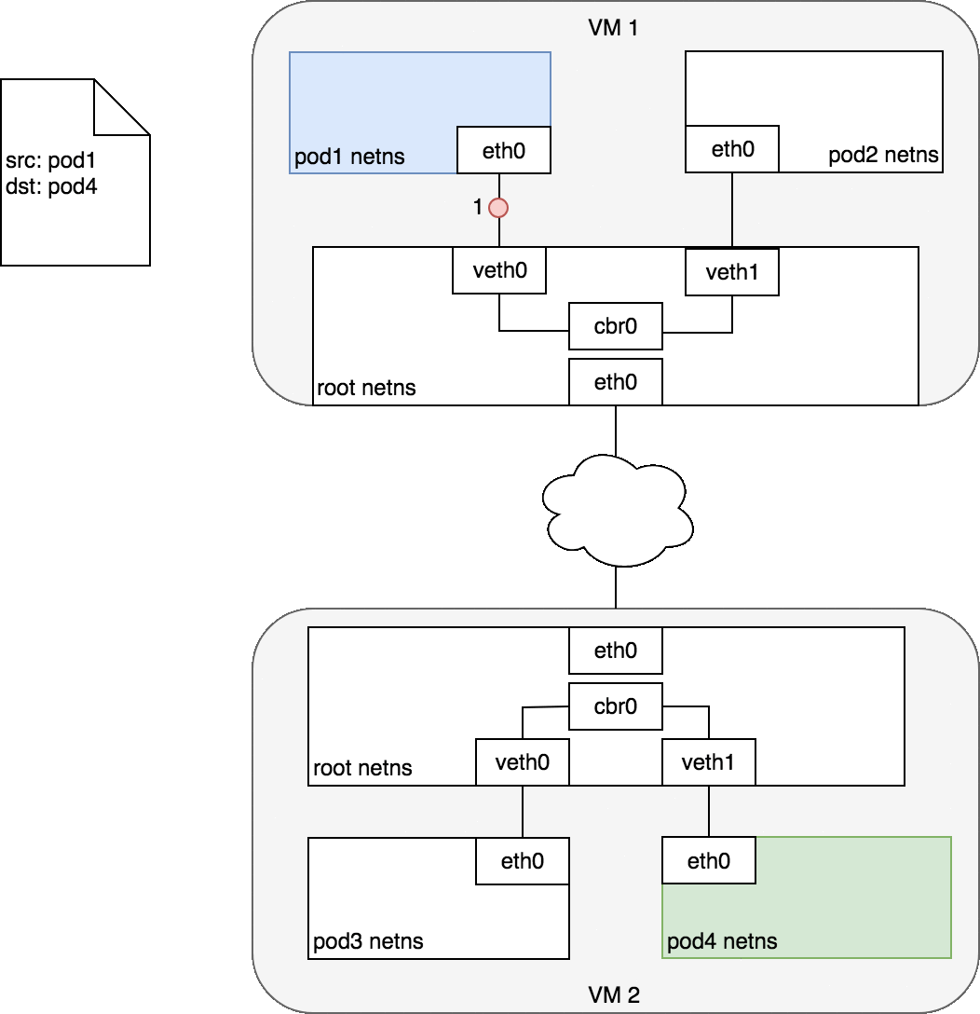
Pods on different nodes
Kubernetes doesn’t care how the nodes are connected. We can use L2 (ARP across nodes), L3 (IP routing across nodes — like the cloud provider route tables), overlay networks, etc.
Every node is assigned a unique CIDR block (a range of IP addresses) for pod IPs, so each pod has a unique IP that doesn’t conflict with pods on another node.
In most of the cases, especially in cloud environments, the cloud provider route tables do the routing. Different network plugins do their own thing, for example calico use BGP to learn route between them.
When the network bridge asks all the connected devices (i.e. pods) if they have the right IP address, none of them will say yes.
After that, the bridge falls back to the default gateway. This goes up to the cluster level and looks for the IP address.
At the cluster level, there’s a table that maps IP address ranges to various nodes. Pods on those nodes will have been assigned IP addresses from those ranges.
For example, Kubernetes might give pods on node 1 addresses like 100.96.1.1, 100.96.1.2, etc. And Kubernetes gives pods on node 2 addresses like 100.96.2.1, 100.96.2.2, and so on.
Then this table will store the fact that IP addresses that look like 100.96.1.xxx should go to node 1, and addresses like 100.96.2.xxx need to go to node 2.

Slide 16
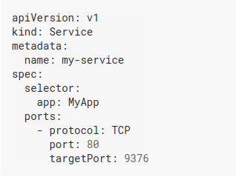
Service
Pods are ephemeral. The services that they provide may be critical, but because Kubernetes can terminate Pods at any time, they are unreliable endpoints for direct communication. So Kubernetes offers the Service resource, which provides a stable IP address and balances traffic across all of the Pods behind it.
Services use a selector and labels to find the Pods they manage.
All Pods with a label that matches the selector receive traffic through the Service.
Kind = Service
Name of the service
Label selector
map any incoming port to a targetPort
This specification creates a new Service object named “my-service”, which targets TCP port 9376 on any Pod with the app=MyApp label.
Kubernetes ServiceTypes allow you to specify what kind of Service you want. The default is ClusterIP.
Others are Nodeport, Load balancer, ExternalName.

Slide 17
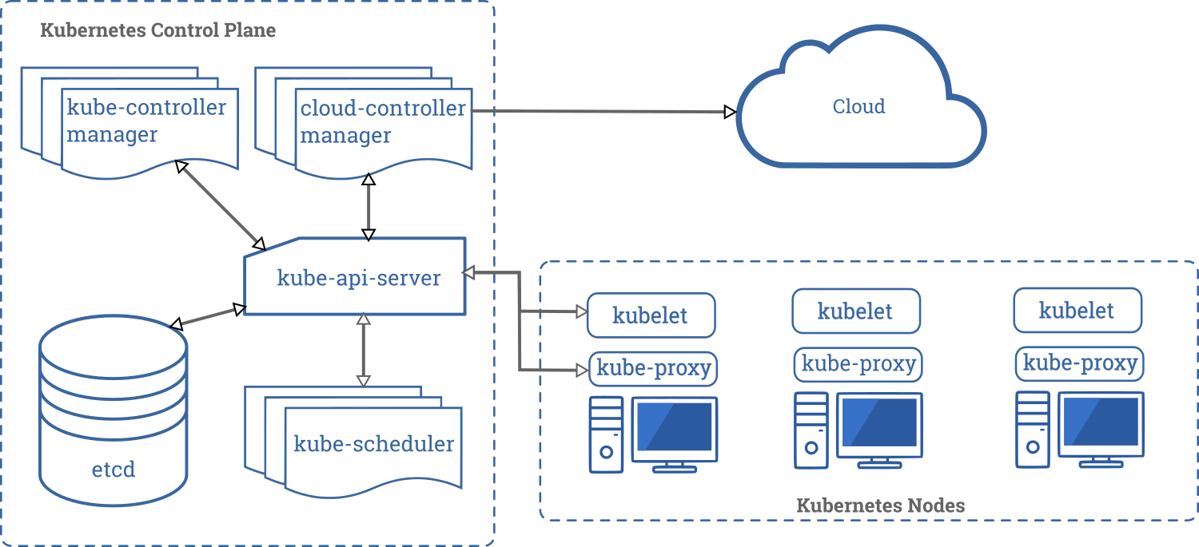
Kube-Proxy
The kube-proxy daemon that runs on all nodes of the cluster allows the Service to map traffic from one port to another. This component configures the Netfilter rules on all of the nodes according to the Service’s definition in the API server.
3 Modes of running kube-proxy:
Userspace: kube-proxy receives the traffic in userspace and send to backend pods.
Iptables: kube-proxy configure iptables rules such a way that traffic load balancing happens in the kernel. No userspace involve.
Ipvstables: Same as above, use ipvs table instead of ip tables. This is better than iptables in term of scaling and performance.

Slide 18
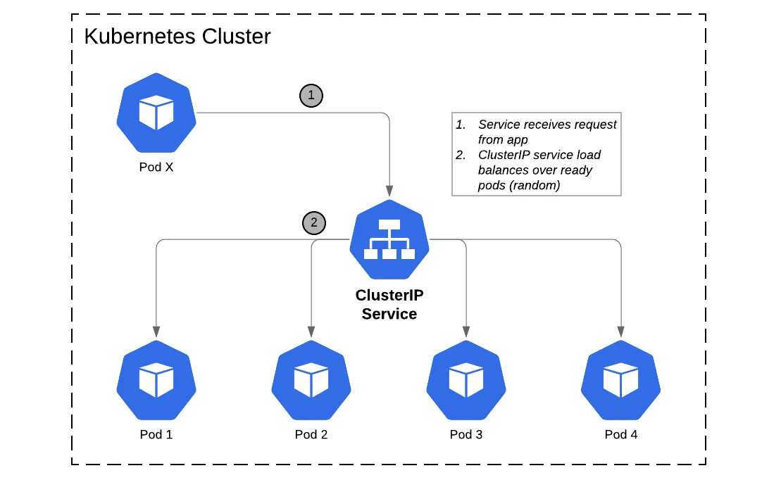
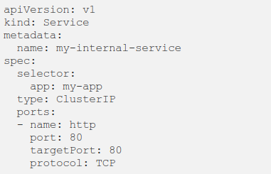
Cluster-IP
This type of Service is the default.
Exists on an IP that is only visible within the cluster.
It enables cluster resources to reach one another via a known address while maintaining the security boundaries of the cluster itself.

Slide 19
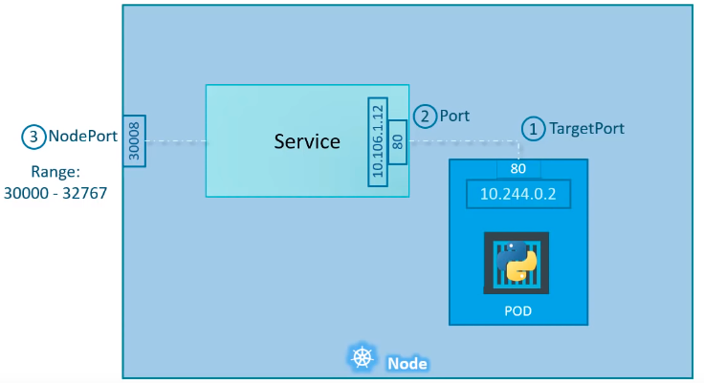
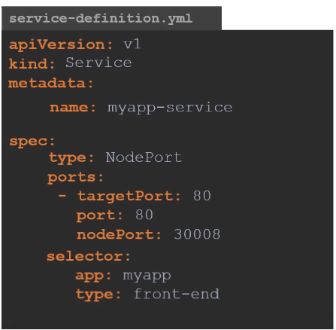
Node Port
A Service of type NodePort exposes the same port on every node of the cluster. The range of available ports is a cluster-level configuration item, and the Service can either choose one of the ports at random or have one designated in its configuration. This type of Service automatically creates a ClusterIP Service as its target, and the ClusterIP Service routes traffic to the Pods

Slide 20
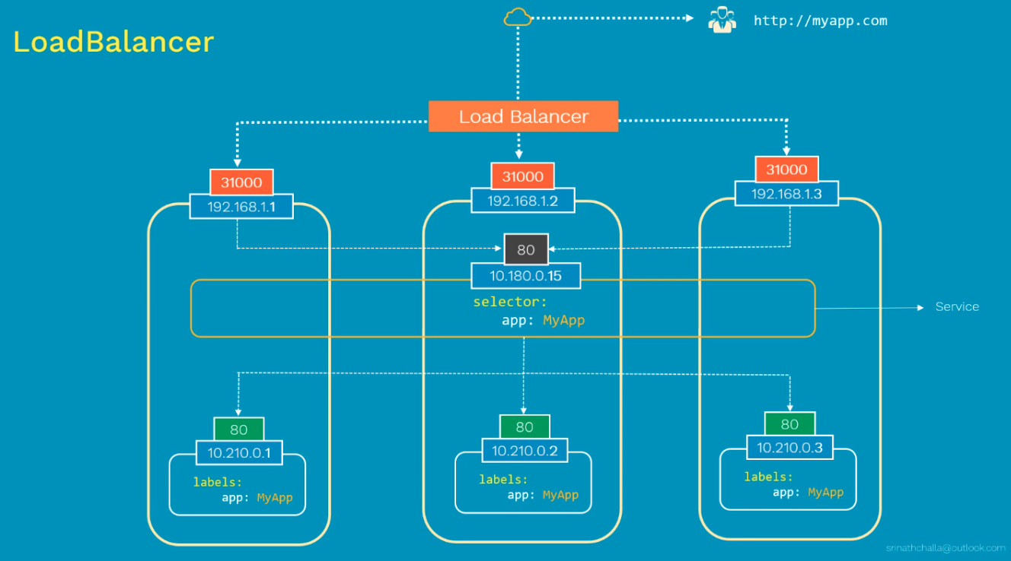
Load balancer
The problem with the nodeport is it allocates a port from a range 30000–32767 dynamically. Therefore standard ports such as 80, 443 or 8443 are cannot be used. Because of this dynamic allocation, you do not know the assigned port in advance.
Declaring a Service as LoadBalancer exposes it externally, using a cloud provider’s load balancer solution (In case of baremetal you may need to create your own). This external load balancer is associated with a specific IP address and routes external traffic to a Kubernetes service in your cluster.
The cloud provider will provision a load balancer for the Service, and map it to its automatically assigned NodePort.
Loadbalancer provides load balancing at L7 layer(HTTP) and advanced routing rules based on HTTP header etc.
Disadvantage is that each service you expose with a LoadBalancer will get its own IP address, in other words Every time you want to expose a new service to the outside world, you have to create a new LoadBalancer and get an IP address.

Slide 21
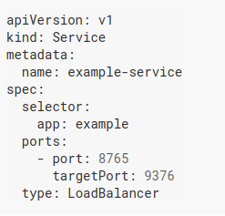
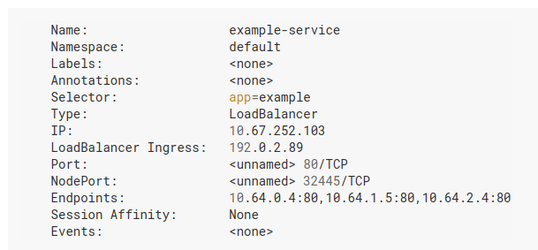
Load balancer

Slide 22
DNS
As we stated above, Pods are ephemeral, and because of this, their IP addresses are not reliable endpoints for communication.
Although Services solve this by providing a stable address in front of a group of Pods, consumers of the Service still want to avoid using an IP address. Kubernetes solves this by using DNS for service discovery.
A service named kube-dns and one or more pods are created.
The kube-dns service listens for service and endpoint events from the Kubernetes API and updates its DNS records as needed. These events are triggered when you create, update or delete Kubernetes services and their associated pods.
kubelet sets each new pod’s /etc/resolv.conf nameserver option to the cluster IP of the kube-dns service.
Applications running in containers can then resolve hostnames such as example-service.namespace into the correct cluster IP addresses.
A Kube-DNS Pod consists of three separate containers:
kubedns: watches the Kubernetes master for changes in Services and Endpoints, and maintains in-memory lookup structures to serve DNS requests.
dnsmasq: adds DNS caching to improve performance.
sidecar: provides a single health check endpoint to perform healthchecks for dnsmasq and kubedns.

Slide 23
DNS
The default internal domain name for a cluster is cluster.local. When you create a Service, it assembles a subdomain of my-svc.my-namespace.svc.cluster.local (where my-namespace is the namespace in which the my-svc is running) and sets its name as the hostname. For example, if the service was named nginx and ran in the default namespace, consumers of the service would be able to reach it as nginx.default.svc.cluster.local.
If the service's IP changes, the hostname remains the same. There is no interruption of service.
“Headless” (without a cluster IP) Services are also assigned a DNS A or AAAA record, depending on the IP family of the service, for a name of the form my-svc.my-namespace.svc.cluster-domain.example. Unlike normal Services, this resolves to the set of IPs of the pods selected by the Service.
A headless service is a service with a service IP but instead of load-balancing it will return the IPs of our associated Pods.
Notes:
apiVersion: v1
kind: Service
metadata:
name: headless-service
spec:
clusterIP: None # <-- Don't forget!!
selector:
app: api
ports:
- protocol: TCP
port: 80
targetPort: 3000

Slide 24
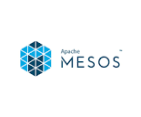
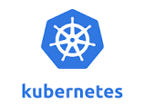

What is CNI Specification
1. Create Network Namespace
2. Create Bridge network/Interface
3. Create vETH pairs
4. Attach vETH to namespace
5. Attach other vETH to bridge
All Does the same work but in little different way. Different parameter etc.
6. Assign Ip address
7. Bring the interfaces up
8. Enable NAT, modify ip tables

Slide 25
What is CNI Specification
1. Create Network Namespace
Bridge
2. Create Bridge network/Interface
3. Create vETH pairs
Name this program/plugin as bridge
4. Attach vETH to namespace
Runtime calls this program after creating container.
It calls in a standard way.
It passes standard parameters
It expect standard result after invoking the plugin.
5. Attach other vETH to bridge
6. Assign Ip address
7. Bring the interfaces up
CNI defines these standard
8. Enable NAT, modify ip tables

Slide 26
CNI
Runtime
Container Runtime must create network namespace.
Identify network the container must attach to
Container Runtime to invoke Network plugin (bridge) when container added.
Container Runtime to invoke Network plugin (bridge) when container Deleted.
Json format of the network configuration.
CNI commands and network config
Config
Net plugin
Must support command line arguments of ADD/DEL/GET
Must support parameters such as container id, network ns etc,
Must manage ip address assignment to pods.
Must return results in a specific format
Configures network

Slide 27



CNI Plugin Examples
Bridge
VLAN
IPVLAN
MACVLAN
DHCP
host-local
Static
Firewall
Port map
Bandwidth

Slide 28
K8s Networking Model

Slide 29
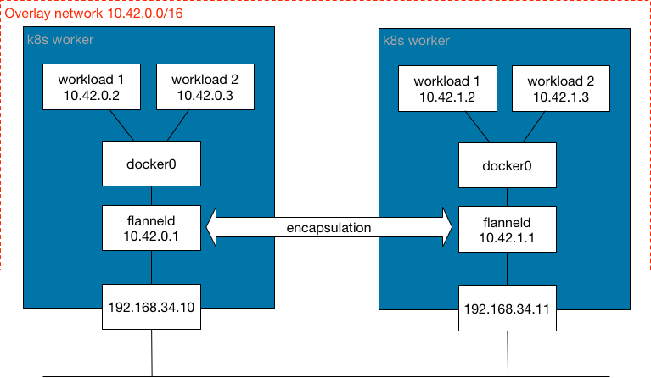
The Kubernetes network model specifies:
Every pod gets its own IP address
Containers within a pod share the pod IP address and can communicate freely with each other
Pods can communicate with all other pods in the cluster using pod IP addresses (without NAT)
Isolation (restricting what each pod can communicate with) is defined using network policies
3
4
Service: cluster ip
(Rules to iptable)
2
1
1
2
3
4
When Kubernetes schedules a Pod to run on a node, it creates a network namespace for the Pod in the node's Linux kernel. This network namespace connects the node's physical network interface, such as eth0, with the Pod using a virtual network interface, so that packets can flow to and from the Pod. The associated virtual network interface in the node's root network namespace connects to a Linux bridge that allows communication among Pods on the same node. A Pod can also send packets outside of the node using the same virtual interface.
Kubernetes assigns a stable, reliable IP address to each newly-created Service (the ClusterIP) from the cluster's pool of available Service IP addresses. Kubernetes also assigns a hostname to the ClusterIP, by adding a DNS entry. The ClusterIP and hostname are unique within the cluster and do not change throughout the lifecycle of the Service.
Underlay network: The physical connection between the nodes should be there or set up first. It could be over same or different VPC network, or could be setup by admin.
Though k8s does not mentioned more than this, the CNI who creates overlay on this must be able to support such underlay. Eg, Flannel can work if Nodes are on same network, calico can support nodes from different network.
Overlay network: CNI may creates overlay network using tunnel.
NOTE: Whether it is required to have overlay depends on CNI and underlay.
In general overlays/encapsulation can be useful when running on top of an underlying network that cannot easily be made aware of workload IPs.

Slide 30
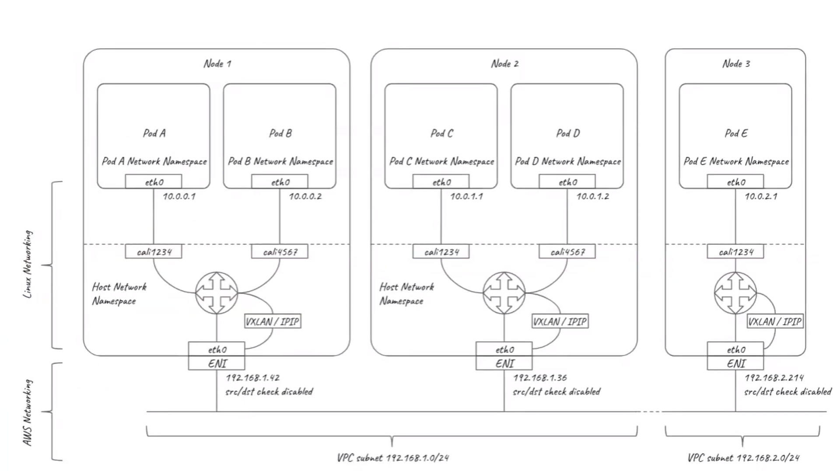
Example Calico Network

Slide 31
 | Node IP | Pod IP | Cluster IP/Service IP/Virtual IP
Description: | Host IP Or assigned from the cluster's Virtual Private Cloud (VPC) network. This node IP provides connectivity from control components like kube-proxy and the kubelet to the Kubernetes API server. This IP is the node's connection to the rest of the cluster. Static Pods use node ip as the pod Ip. (They use root net namespace) | Each node has a pool of IP addresses that CNI assigns to the Pods (except static pods) running on that node. Each Pod has a single IP address assigned from the Pod CIDR range of its node. This IP address is shared by all containers running within the Pod, and connects them to other Pods running in the cluster. | Kubernetes assigns a stable, reliable IP address to each newly-created Service (the ClusterIP) from the cluster's pool of available Service IP addresses. Kubernetes also assigns a hostname to the ClusterIP, by adding a DNS entry. ClusterIP and hostname are unique within the cluster and do not change throughout the lifecycle of the Service Kubernetes only releases the ClusterIP and hostname if the Service is deleted from the cluster's configuration. You can reach a healthy Pod running your application using either the ClusterIP or the hostname of the Service. Kubernetes spreads traffic as evenly as possible across the full set of Pods, running on many nodes, so a cluster can withstand an outage affecting one or more (but not all) nodes.
How to configure | Assigned by Admin (Eg, Openstack if the VM is created by openstack, Or get from VPC) | Kubeadm init --pod-network-cidr=192.168.0.0/16 | Kubeadm init --service-cidr=10.20.0.0/16 Default: "10.96.0.0/12"
Who manages | Admin, VPC owner | CNI | Kube-api-server or service controller // Not sure https://stackoverflow.com/questions/68999286/who-assign-clusterip-to-service-in-kubernetes-could-it-be-disabled

Slide 32
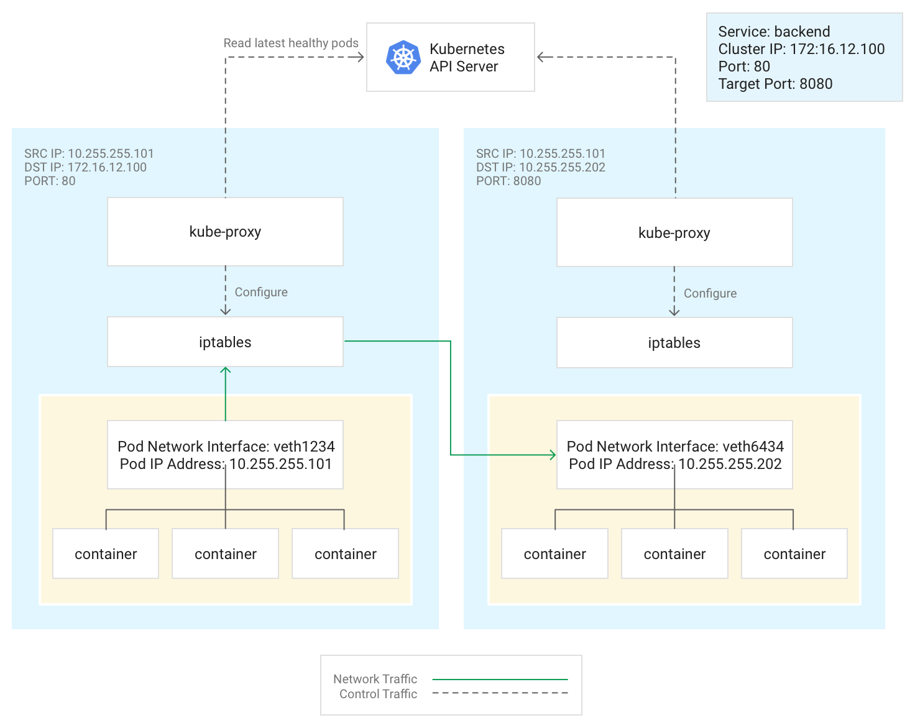
Kube-Proxy
Kubernetes manages connectivity among Pods and Services using the kube-proxy component, which is a DaemonSet that deploys a Pod on each node by default.
kube-proxy, which is not an in-line proxy, but an egress-based load-balancing controller, watches the Kubernetes API server and continually maps the ClusterIP to healthy Pods by adding and removing destination NAT (DNAT) rules to the node's iptables subsystem. When a container running in a Pod sends traffic to a Service's ClusterIP, the node selects a Pod at random and routes the traffic to that Pod.
When you configure a Service, you can optionally remap its listening port by defining values for port and targetPort.
The port is where clients reach the application.
The targetPort is the port where the application is actually listening for traffic within the Pod.
kube-proxy manages this port remapping by adding and removing iptables rules on the node.
This diagram illustrates the flow of traffic from a client Pod to a server Pod on a different node. The client connects to the Service at 172.16.12.100:80. The Kubernetes API server maintains a list of Pods running the application. The kube-proxy process on each node uses this list to create an iptables rule to direct traffic to an appropriate Pod (such as 10.255.255.202:8080). The client Pod does not need to be aware of the topology of the cluster or any details about individual Pods or containers within them.

Slide 33
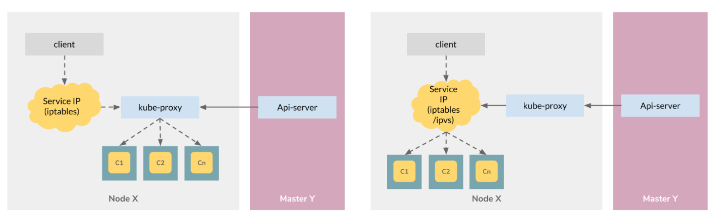
Kube-proxy Mode
kube-proxy starts up in different modes, which are determined by its configuration. Can modify using kubectl edit cm/kube-proxy -n kube-system. Change the mode accordingly.
userspace proxy mode
The userspace mode is old and inefficient. The packet is compared against iptables rule and then forwarded to a pod named kube-Proxy, which operates as an application to forward packet to backend pods.
Ip table mode
In this mode, kube-proxy watches the Kubernetes control plane for the addition and removal of Service and Endpoint objects. For each Service, it installs iptables rules, which capture traffic to the Service's clusterIP and port, and redirect that traffic to one of the Service's backend sets. For each Endpoint object, it installs iptables rules which select a backend Pod.
By default, kube-proxy in iptables mode chooses a backend at random
Ipvs mode
In ipvs mode, kube-proxy watches Kubernetes Services and Endpoints, calls netlink interface to create IPVS rules accordingly and synchronizes IPVS rules with Kubernetes Services and Endpoints periodically. This control loop ensures that IPVS status matches the desired state. When accessing a Service, IPVS directs traffic to one of the backend Pods.
The IPVS proxy mode is based on netfilter hook function that is similar to iptables mode, but uses a hash table as the underlying data structure and works in the kernel space. That means kube-proxy in IPVS mode redirects traffic with lower latency than kube-proxy in iptables mode, with much better performance when synchronising proxy rules. Compared to the other proxy modes, IPVS mode also supports a higher throughput of network traffic.

Slide 34
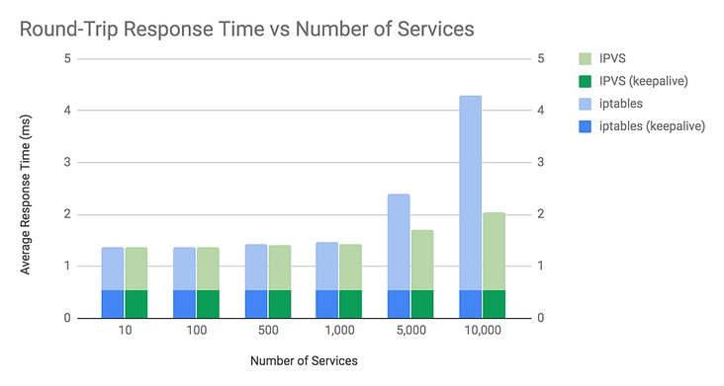
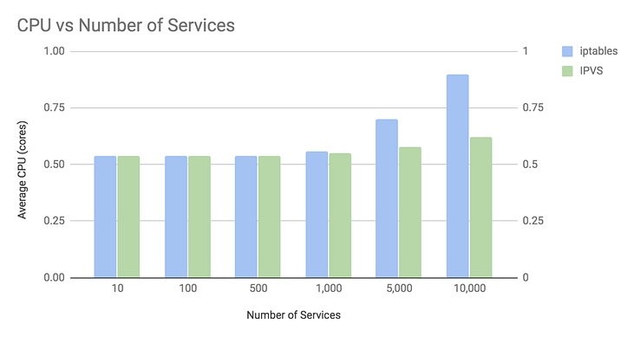
IP vs IPVS
https://www.tigera.io/blog/comparing-kube-proxy-modes-iptables-or-ipvs/
Iptables is a Linux kernel feature that was designed to be an efficient firewall with sufficient flexibility to handle a wide variety of common packet manipulation and filtering needs. It allows flexible sequences of rules to be attached to various hooks in the kernel’s packet processing pipeline. In iptables mode, kube-proxy attaches rules to the “NAT pre-routing” hook to implement its NAT and load balancing functions. This works, it’s simple, it uses a mature kernel feature, and, it “plays nice” with other programs that also work with iptables for filtering (such as Calico!).
However, the way kube-proxy programs the iptables rules means that it is nominally an O(n) style algorithm, where n grows roughly in proportion to your cluster size (or more precisely the number of services and number of backend pods behind each service).
IPVS is a Linux kernel feature that is specifically designed for load balancing. In IPVS mode, kube-proxy programs the IPVS load balancer instead of using iptables. This works, it also uses a mature kernel feature and IPVS is designed for load balancing lots of services; it has an optimized API and an optimized look-up routine rather than a list of sequential rules.
The result is that kube-proxy’s connection processing in IPVS mode has a nominal computational complexity of O(1). In other words, in most scenarios, its connection processing performance will stay constant independent of your cluster size. In addition, as a dedicated load balancer, IPVS boasts multiple different scheduling algorithms such as round-robin, shortest-expected-delay, least connections, and various hashing approaches. In contrast, kube-proxy in iptables uses a randomized equal cost selection algorithm.
IPVS is newer feature so it may be possible some older kernel doesn't support it.
At scales significantly beyond 1,000 services, kube-proxy’s IPVS mode can offer some nice performance improvements.

Slide 35
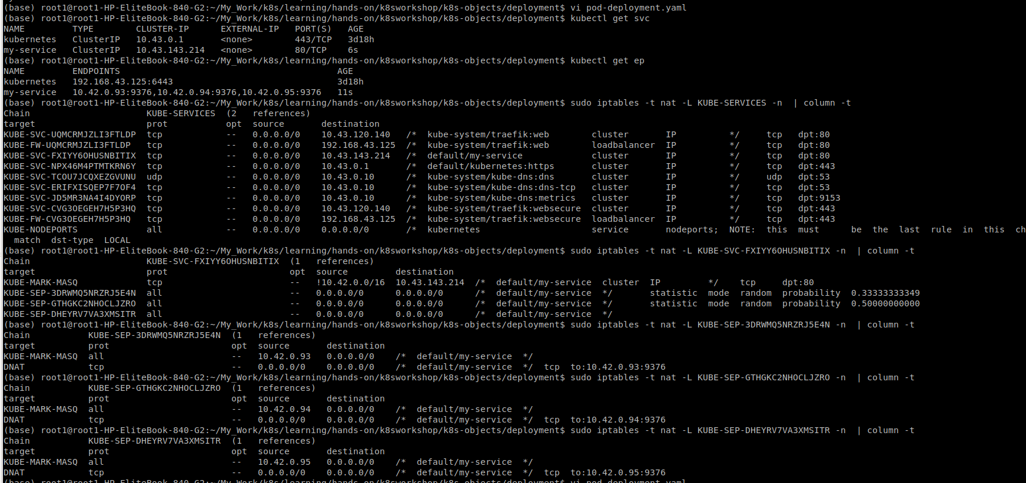
Sample IP table in k8s cluster

Slide 36
Backup Slides

Slide 37
Exercise

Slide 38
Useful Links
https://www.youtube.com/watch?v=BgrQ16r84pM
https://www.ianlewis.org/en/how-kubeadm-initializes-your-kubernetes-master
https://kubernetes.io/docs/concepts/
https://kubernetes.io/docs/reference/setup-tools/kubeadm/kubeadm-init/
https://www.nginx.com/blog/what-are-namespaces-cgroups-how-do-they-work/
https://medium.com/google-cloud/kubernetes-101-pods-nodes-containers-and-clusters-c1509e409e16
https://learnk8s.io/troubleshooting-deployments

